Slide 1
RECRUITING THE RIGHT MENTORS FOR THE TEAM!
Please sit with your region

Slide 2
What makes a good mentor?

Slide 3
TeamMates Stats
Close to 8,000 matches
Average Length of match is 25.8 months
43% of matches reach at least 3 years

Slide 4
How do we get our mentors?
Let’s take a look at the numbers…

Slide 5
Top 3 Program-Wide
Friend: 3,109
Current mentor: 1,879
TeamMates Board Member: 1,383

Slide 6
Top 3: Central Region
One-to-One
Television
Newspaper

Slide 7
Top 3: Northern Region
One-to-One
Newspaper
Nomination

Slide 8
Top 3: Eastern Region
One-to-One
Presentation/Booth
Nomination

Slide 9
Top 3: Southern Region
One-to-One
Business
Faith-based

Slide 10
Top 3: Western Region
One-to-One
Newspaper
Nomination

Slide 11
Top 3: Metro
One-to-One
Business
Presentation/Booth

Slide 12
Use your strengths!
Brainstorm ideas with other members of your region on how to boost your recruitment strategy!

Slide 13
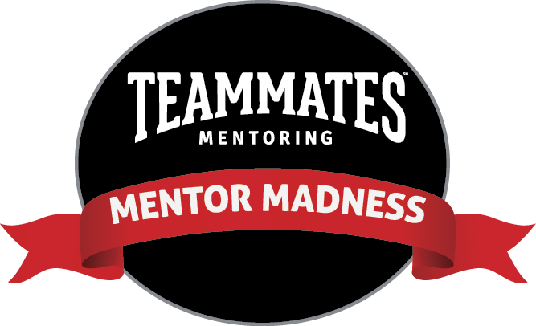
Starting March 2018…

Slide 14
Mentor Madness
1:1 recruitment challenge
Central Office prize for mentor with overall highest number of recruits.

Slide 15
How do we measure our growth?
Check how many mentors you recruit each week.
Fill up the thermometer!

Slide 16
How can our mentors get involved?
Share the toolkit
Encourage your mentors to use social media images in the toolkit
Encourage mentors to nominate their friends online
Hold a mentor meet-up!
Make it a competition within your chapter locally.

Slide 17
Local Prize Ideas
TeamMates Swag
TeamMates Apparel
Mentoring Matters Book
Community Bucks
Amazon gift card
Gift Certificate to local business or restaurant
Their name featured on a special poster

Slide 18
More information will be available in 2018.

Slide 19
Reminders:
Continue recruiting even at the end of the school year or in the summer.
One-to-One is the #1 recruiting method
Utilize the Central Office’s Twitter and Facebook pages
25th Anniversary ends July 1
Runza Day is April 4!

